Slide 1
Title: P-type and n-type materials
Course: Electronic Device
Presented By:
Name: Nafinur Leo
Id: 20-42195-1
Section: J

Slide 2
Outlines:-
1. Introduction
2. P-type materials
3. N-type materials
4. Difference between p-type
and n-type materials
5.Conclusion

Slide 3
Introduction:-
Semiconductor: Semiconductor are materials whose electrical properties
lie between conductors and insulators.
Example: Germanium(Ge), Silicon(SI), Gallium Arsenide(GaAs)
Two-types of semiconductor:
1. Intrinsic semiconductor
2. Extrinsic semiconductor
Two-types of extrinsic materials:
i) P-type material
ii) N-type material

Slide 4
P-type material:-
The extrinsic p-type material is formed when a trivalent impurity
is added to a pure semiconductor in a small amount, and as a result,
a large number of holes are created in it. A large number of holes are
provided in the semiconductor material by the addition of trivalent
impurities like Gallium and Indium.
In p-type, the effect of a positive charge is created in the absence of
an electron.

Slide 5
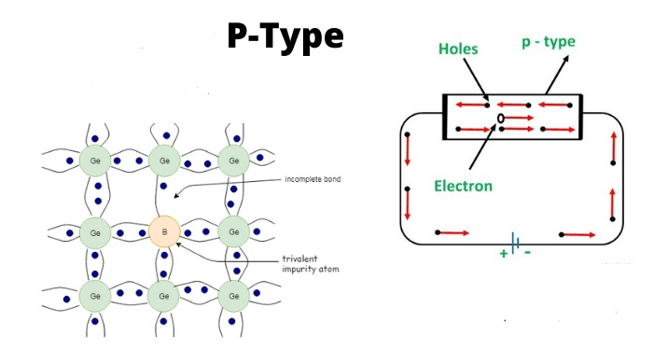
P-type material formed:-

Slide 6
N-type material:-
An n-type semiconductor is a type of material used in electronics.
It is made by adding an impurity to a pure semiconductor such as
silicon or germanium. The impurities used may be phosphorus,
arsenic, antimony, bismuth or some other chemical element. They
are called donor impurities.
An n-type semiconductor results from implanting dopant atoms that
have more electrons in their outer (bonding) shell than silicon. The
resulting semiconductor crystal contains excess or free electrons that
are available for conducting current.

Slide 7
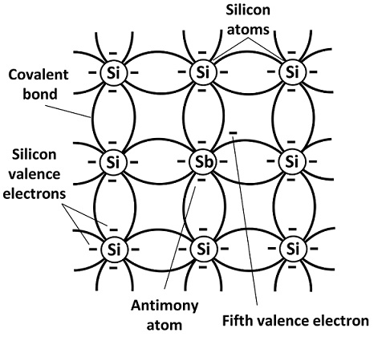
N-type material formed:-

Slide 8
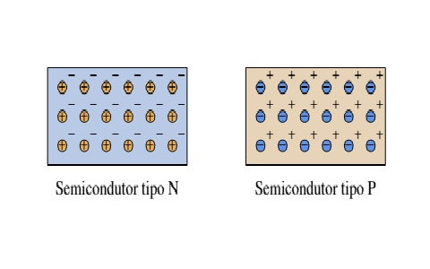
Difference between p-type and n-type materials:-
The impurity added in p-type semiconductor provides extra holes
known as acceptor atom, whereas in n-type semiconductor impurity
provides extra electrons and termed as donor atom. In a p-type
semiconductor, the majority carriers are holes and the minority
carriers are electrons.

Slide 9
Conclusion:-
N-type semi-conductors
In this case, the semi-conductor is given atoms by an impurity
and this impurity is known as donor, so it is given donor
atoms (donated).
P-type semi-conductors
The impurity within the semi-conductor accepts atoms with free
electrons (dopants). This forms a ‘hole’ within the semi-conductors.

Slide 10
Thank
You

